Slide 1



BANL6600_FinalProject_Team ARKA
View in Power BI
Last data refresh:
8/11/2022 3:14:56 AM UTC
Downloaded at:
8/11/2022 3:16:06 AM UTC

Slide 2
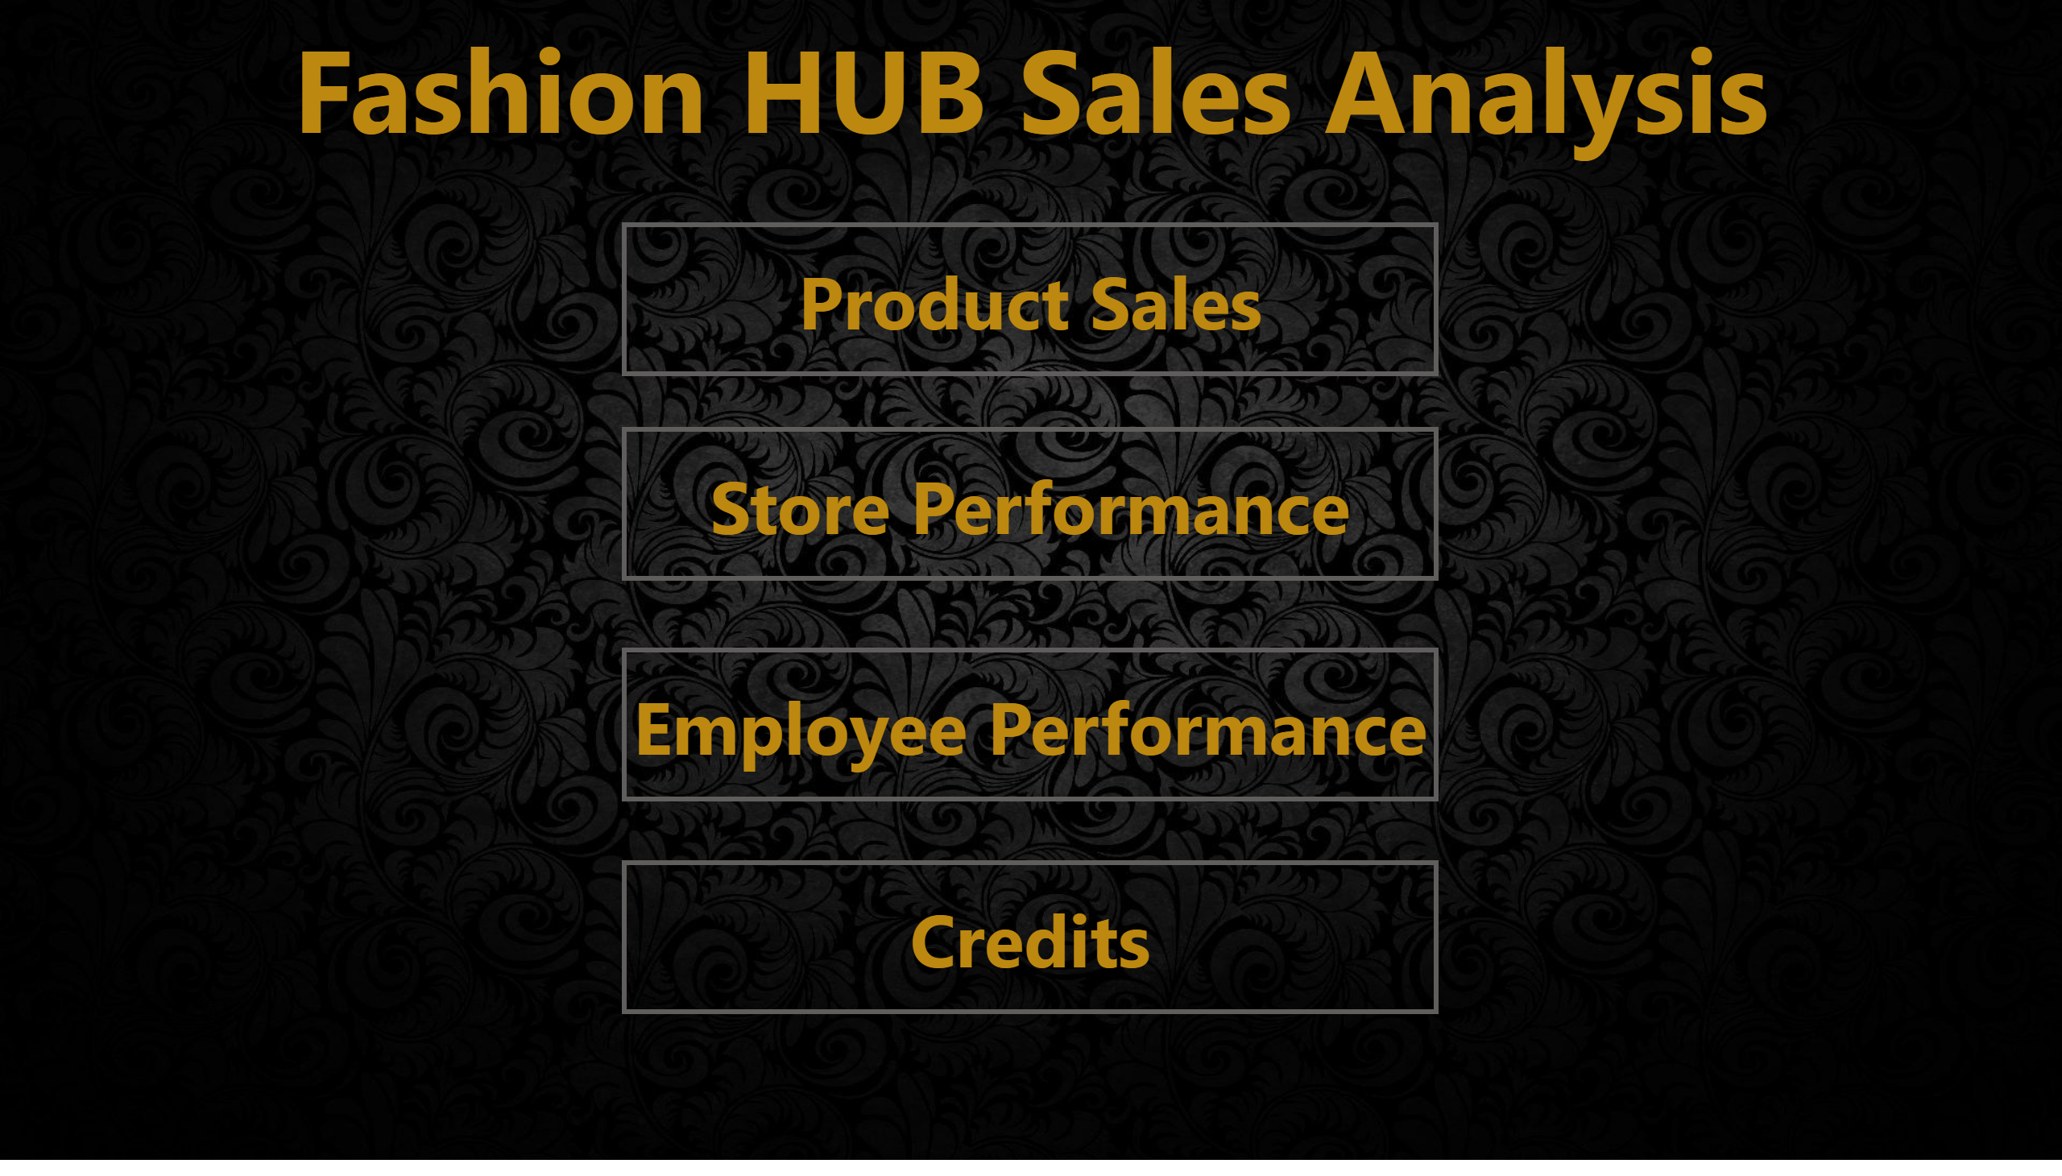
Home Page
Notes:
Product Sales
No alt text provided
textbox
No alt text provided
actionButton
No alt text provided
actionButton
No alt text provided
actionButton
No alt text provided

Slide 3

Problems needs to be Analyzed:
In which Category the sales and profits are high?
Majority of items “sold by product”?
Does sales raise after the pandemic?
From which part of the country, you are getting the least goods?
Which product was sold most by employees?
By whom, you have a least profits?

Slide 4
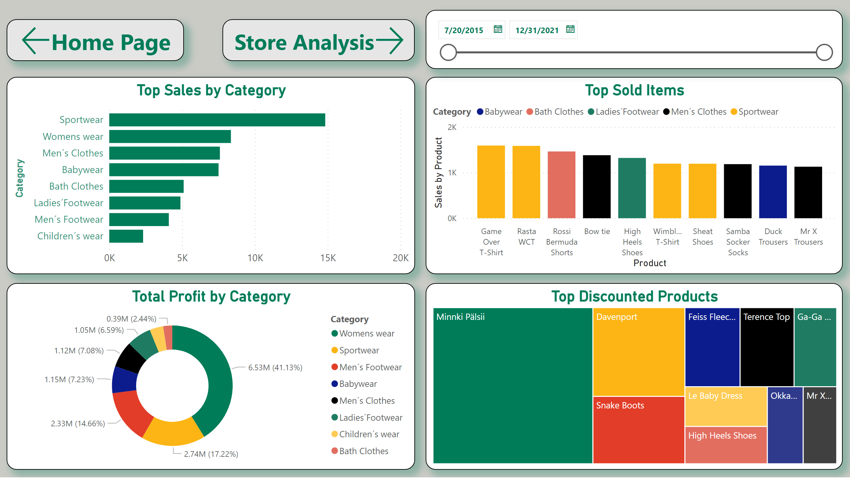
Product_Sales
Notes:
Top Sold Items
No alt text provided
Top Sales by Category
No alt text provided
Total Profit by Category
No alt text provided
Top Discounted Products
No alt text provided
slicer
No alt text provided
actionButton
No alt text provided
actionButton
No alt text provided

Slide 5
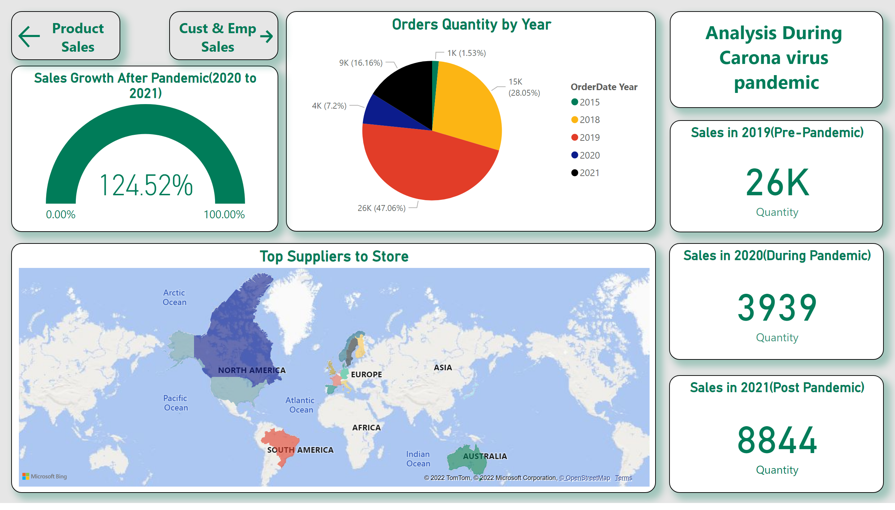
Store_Perfromance
Notes:
Orders Quantity by Year
No alt text provided
Sales Growth After Pandemic(2020 to 2021)
No alt text provided
Top Suppliers to Store
No alt text provided
textbox
No alt text provided
Sales in 2019(Pre-Pandemic)
No alt text provided
Sales in 2020(During Pandemic)
No alt text provided
Sales in 2021(Post Pandemic)
No alt text provided
actionButton
No alt text provided
actionButton
No alt text provided

Slide 6
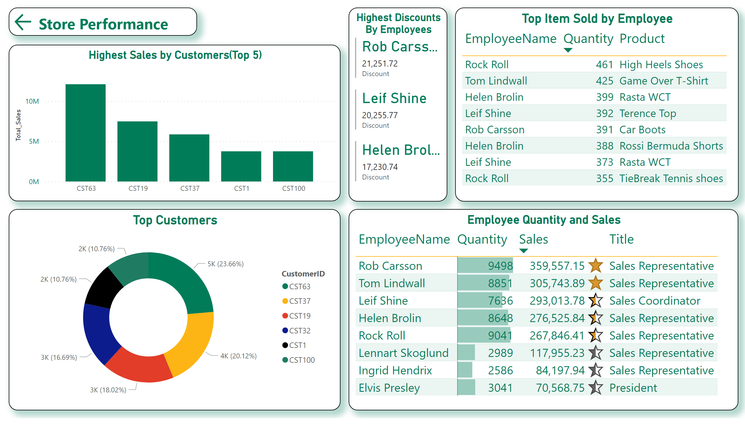
Customers &Emp Sales
Notes:
Employee Quantity and Sales
No alt text provided
Highest Discounts By Employees
No alt text provided
Top Item Sold by Employee
No alt text provided
Top Customers
No alt text provided
Highest Sales by Customers(Top 5)
No alt text provided
actionButton
No alt text provided

Slide 7

Conclusion to Analysis:
The sales are high in Sports wear and Profits are more in Women's wear.
The most sold product in all was “Game Over T-Shirts” that is above 1.5k.
Yes, sales were increased by 124.52 % from the year 2020 to 2021.
We need to concentrate on the “los Hombres Machos” supplier from “Spain” and their supplies was only “1146”.
As usually, women done the shopping most. The employee “Rock Roll” sold the 461 units of “High Heels shoes”.
“Rob Carsson” has given highest discounts with aggregate of $21,255.72, this is the reason, why we have least profit.

Slide 8

Reference :
https://www.kaggle.com/datasets/suraj5a9/sales-data-for-analytics-2021

Slide 9

QR CODE

Slide 10
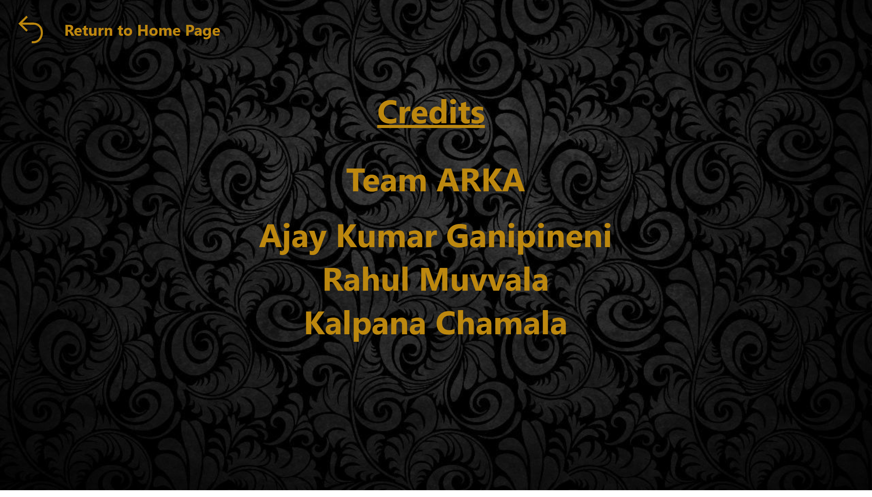
Thank_You
Notes:
bhunb
No alt text provided
actionButton
No alt text provided

Slide 11


